Slide 1
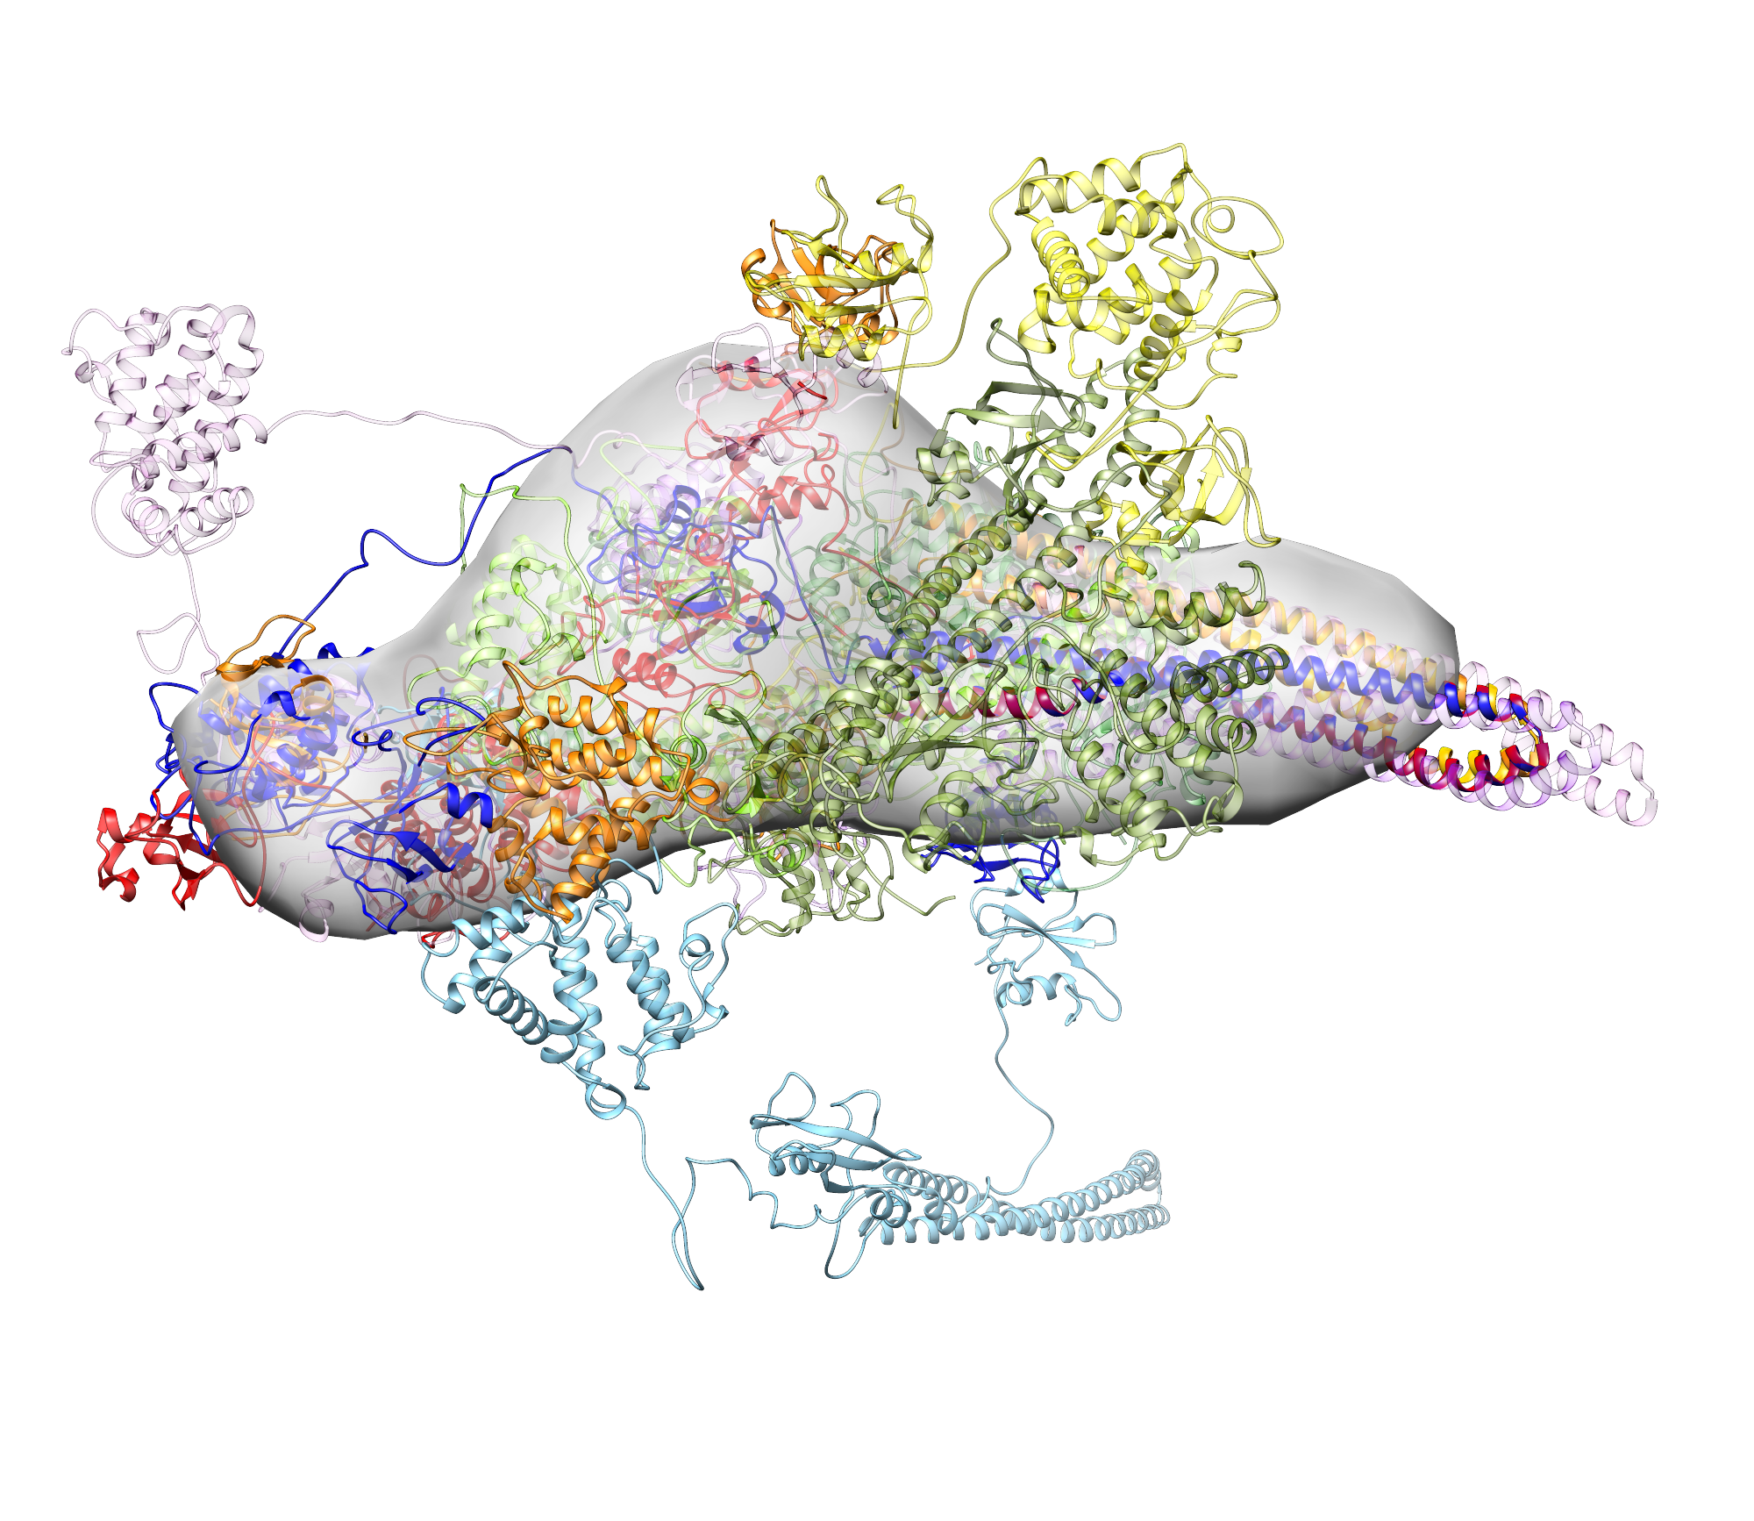
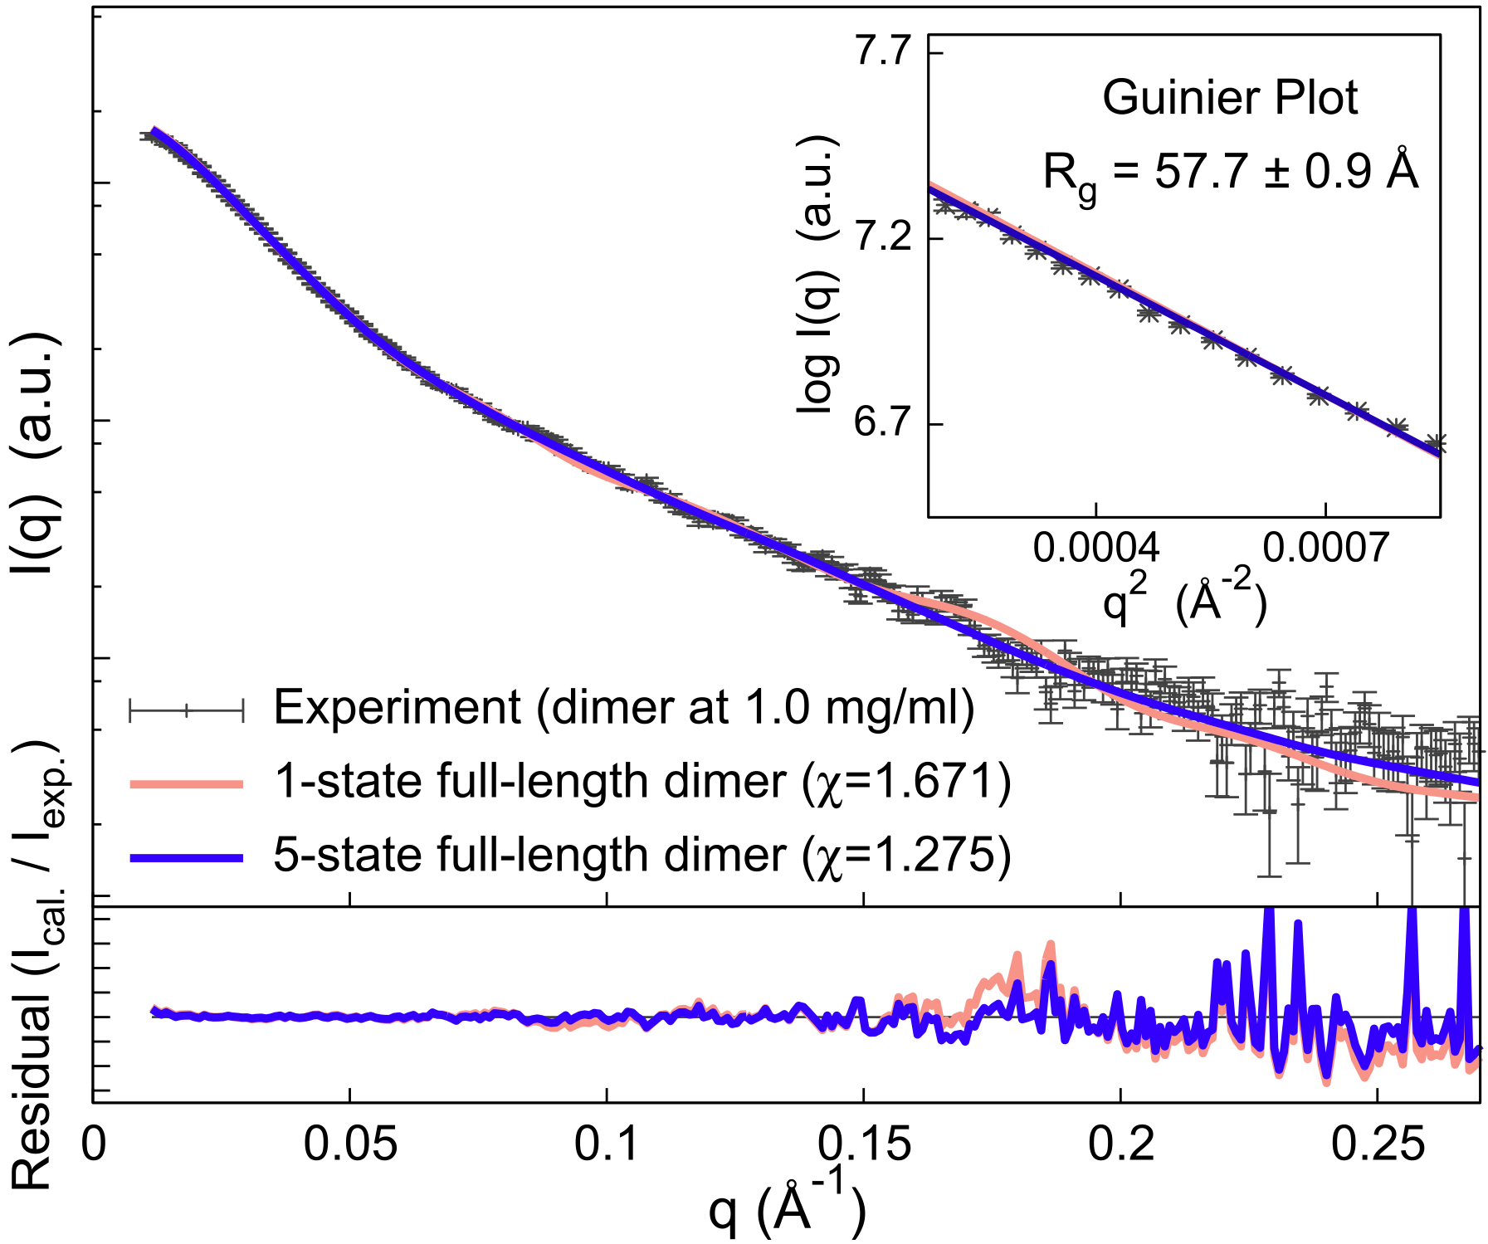
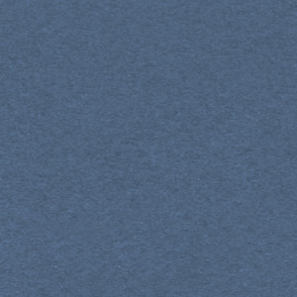
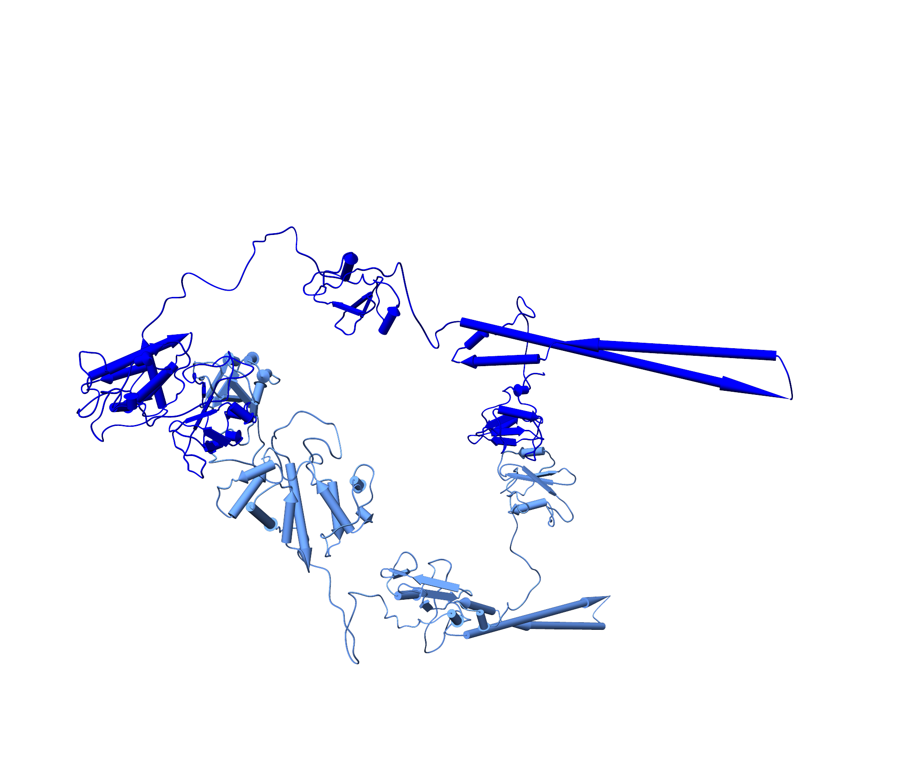
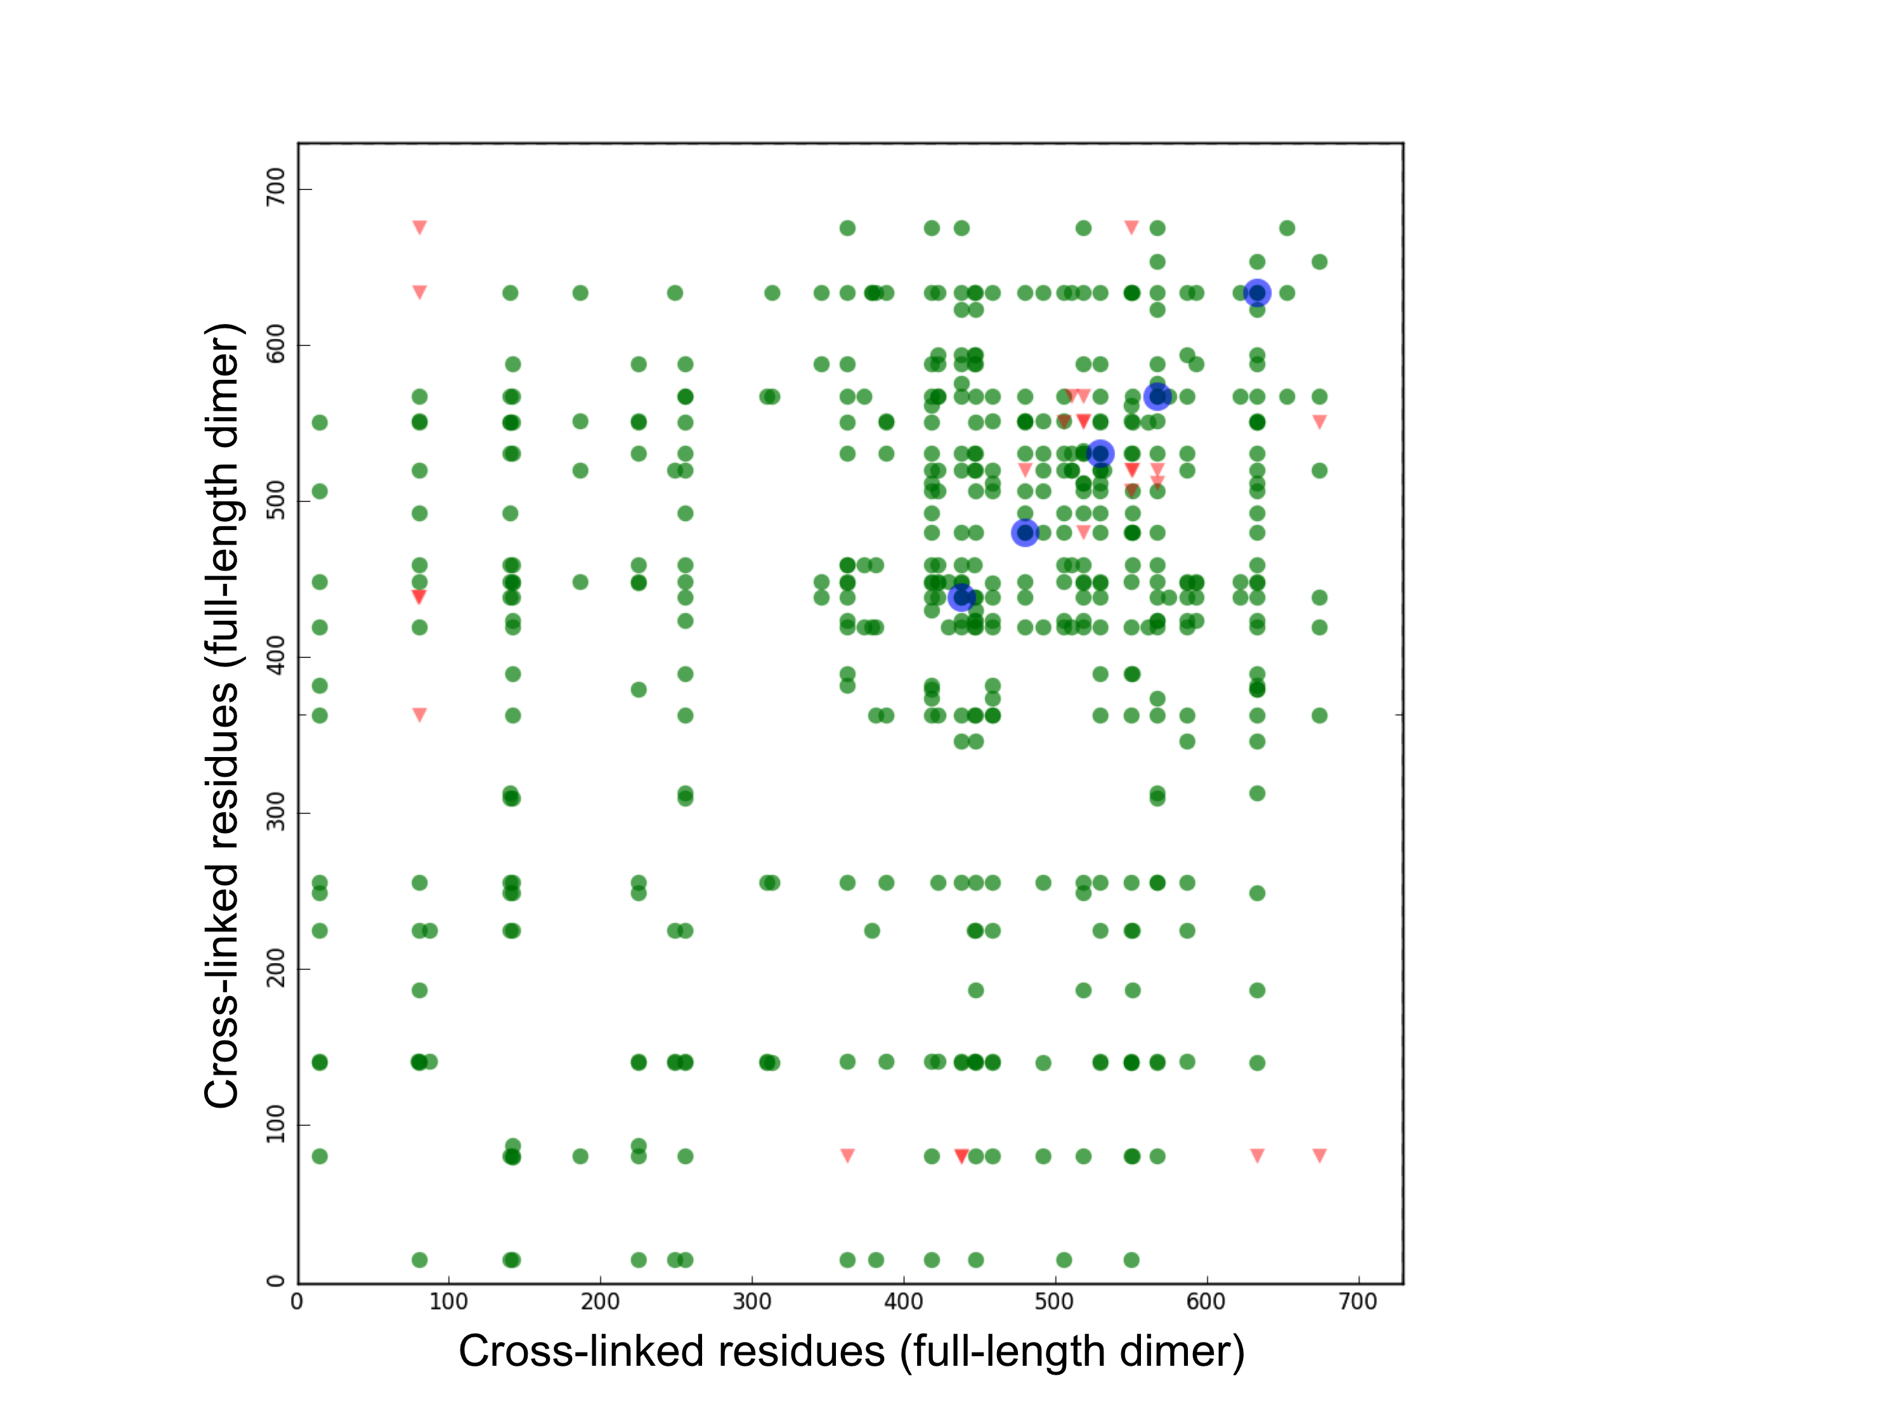
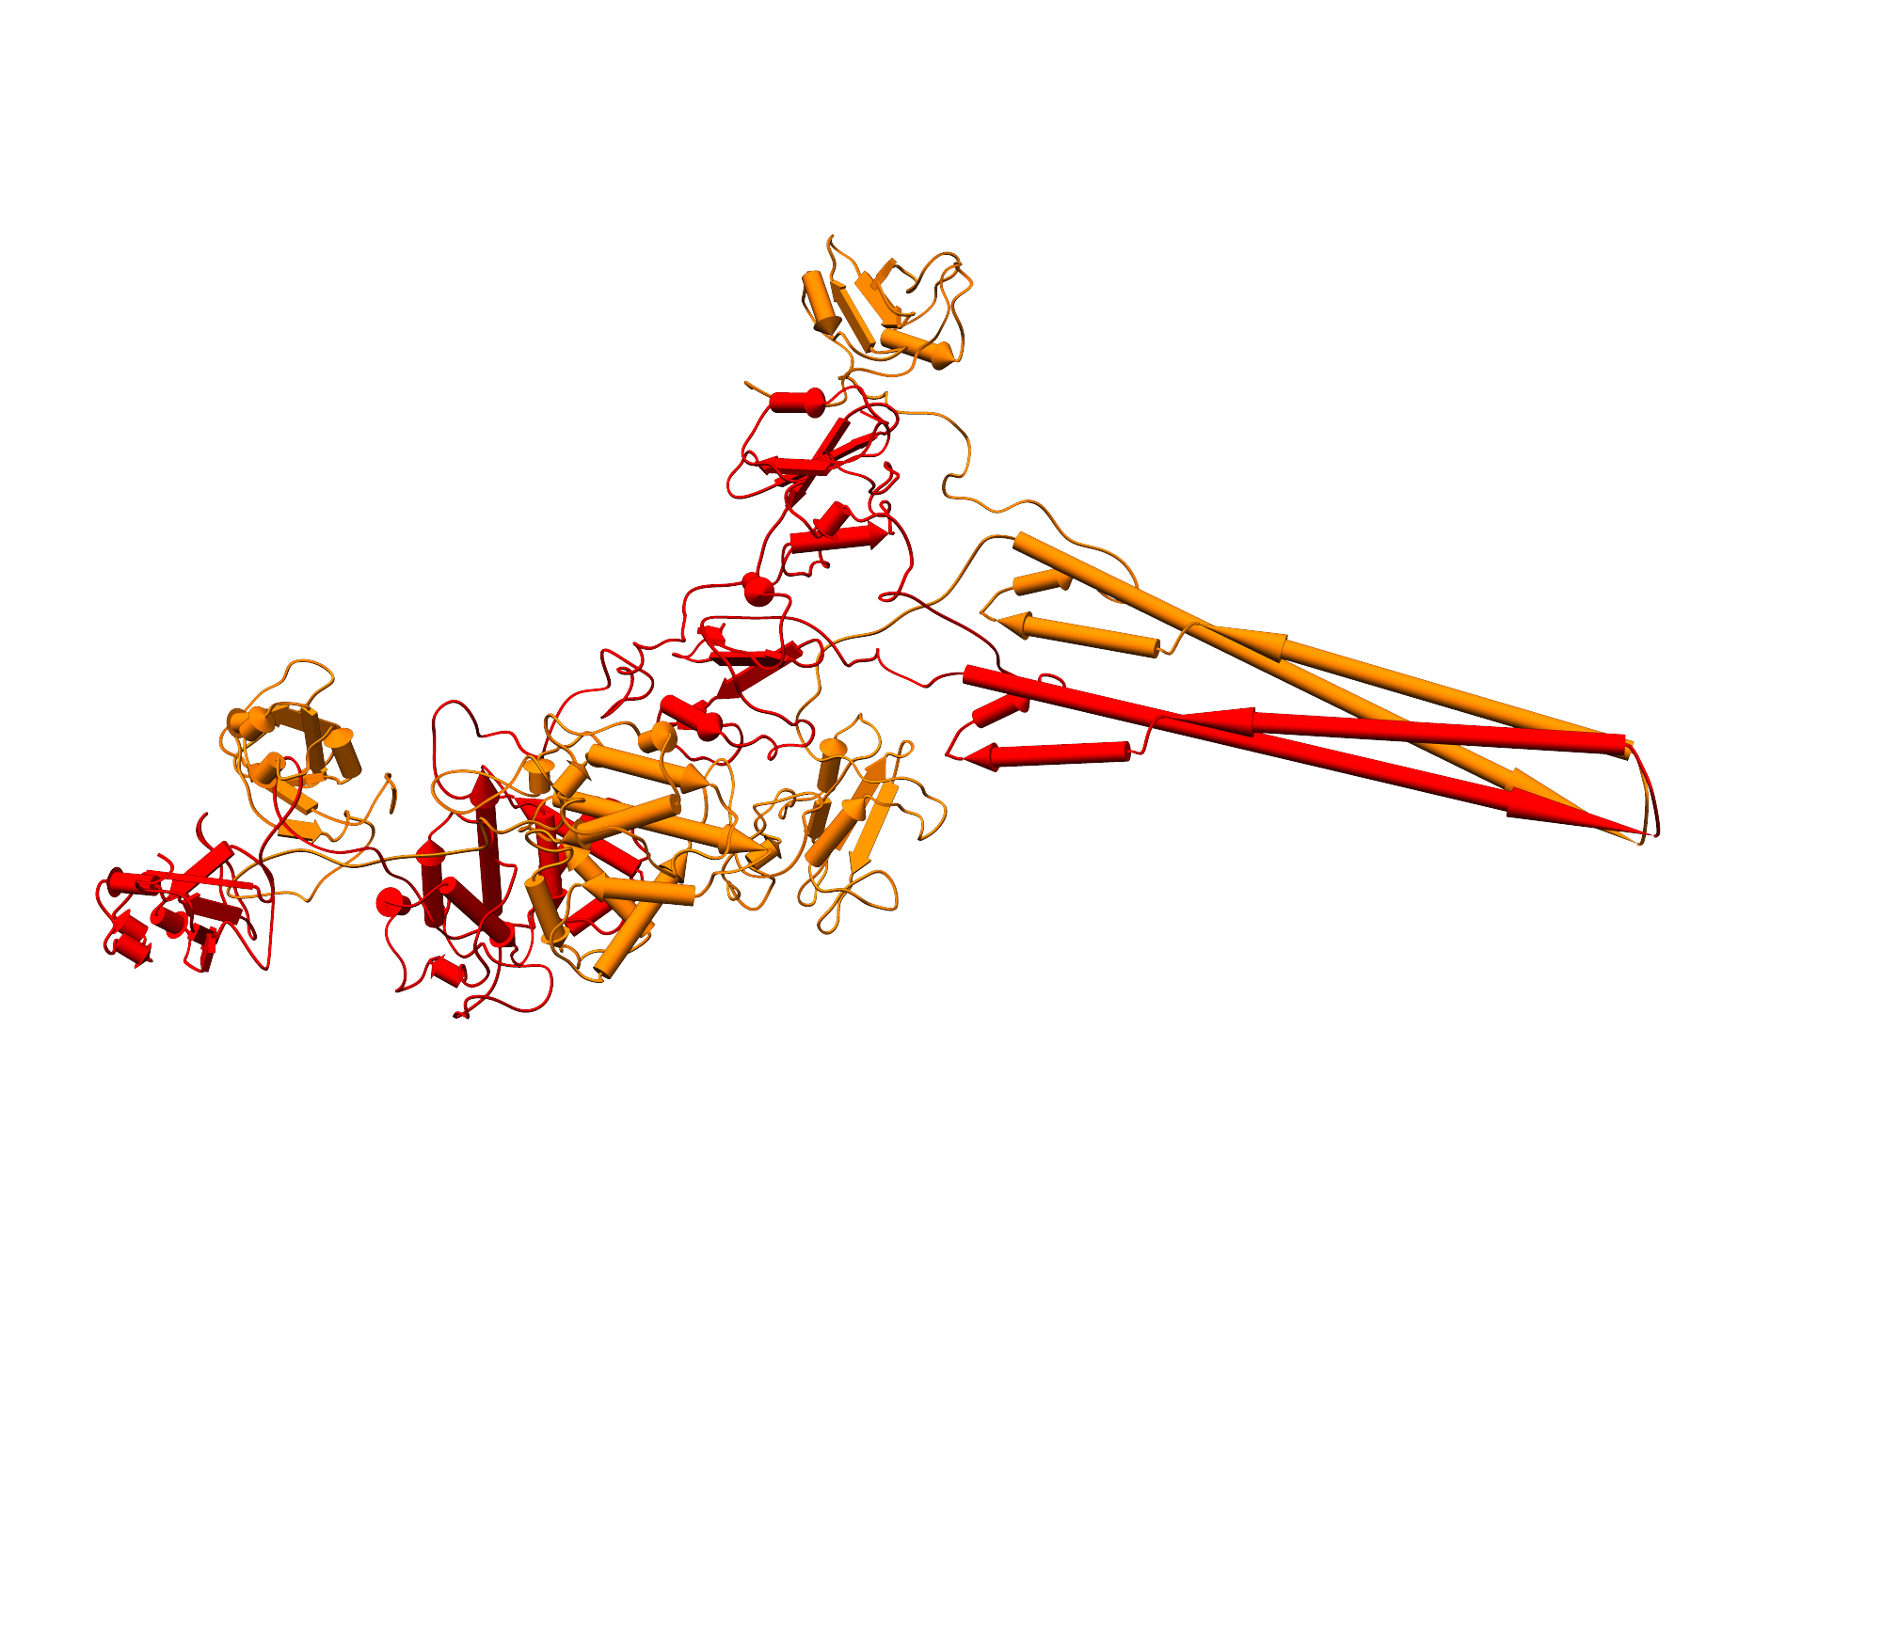
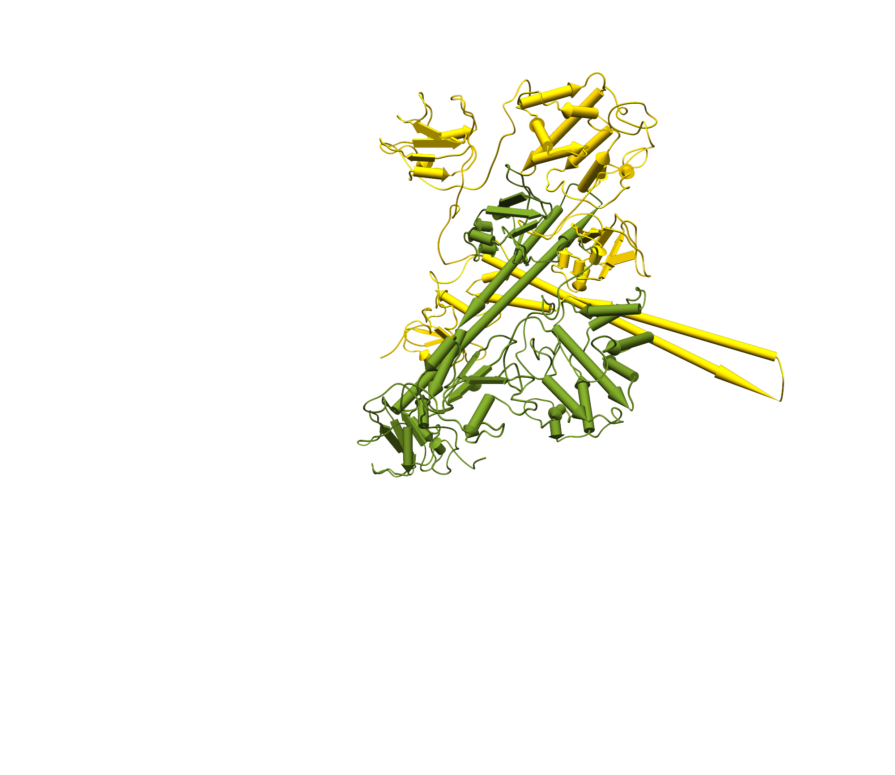
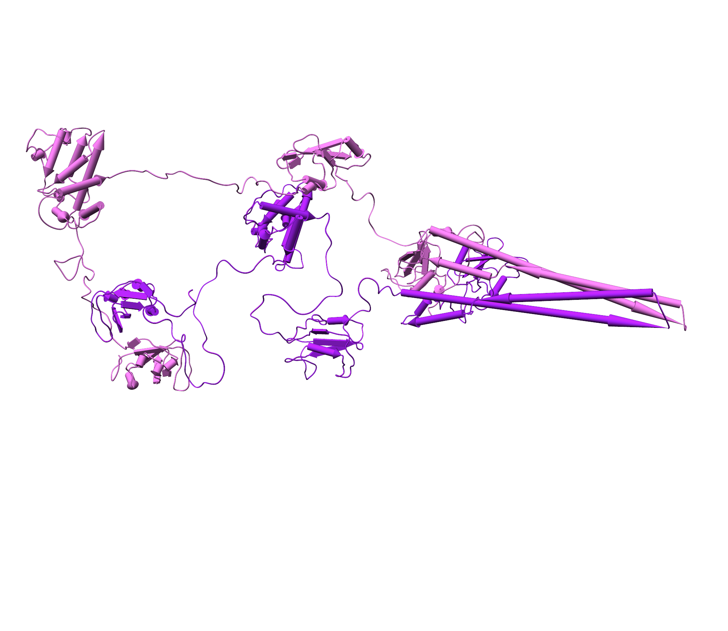
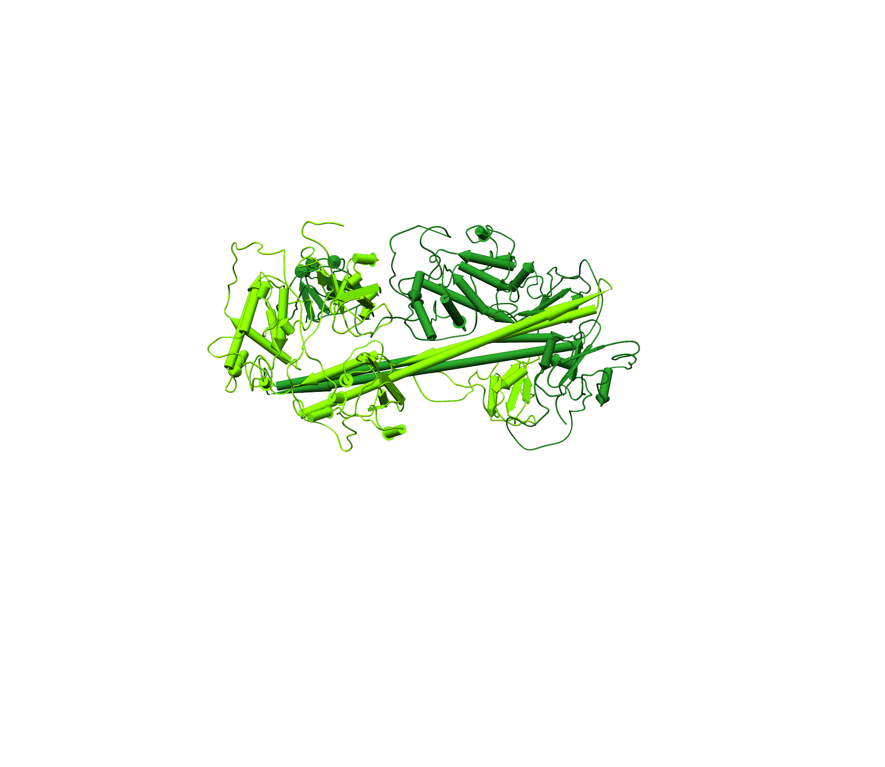
A
B
Ab initio shape by SAXS
~200 Å
C
nSH2
33.2 %
iSH2
BCR
SH3
D
cSH2
SH3
cSH2
Unaligned orientation
of two coiled-coil (iSH2) domains
BCR
nSH2
iSH2
cSH2
27.4 %
18.2 %
nSH2
BCR
cSH2
SH3
SH3
nSH2
iSH2
iSH2
SH3
SH3
cSH2
iSH2
nSH2
iSH2
cSH2
BCR
BCR
nSH2
BCR
nSH2
7.9 %
Perpendicular orientation
of two coiled-coil (iSH2) domains
BCR
BCR
cSH2
cSH2
SH3
iSH2
13.4 %
SH3
SH3
BCR
nSH2
BCR
cSH2
nSH2
iSH2
iSH2
SH3
Parallel orientations
of two coiled-coil (iSH2) domains
nSH2
iSH2
cSH2
Anti-parallel orientation
of two coiled-coil (iSH2) domains

Slide 2
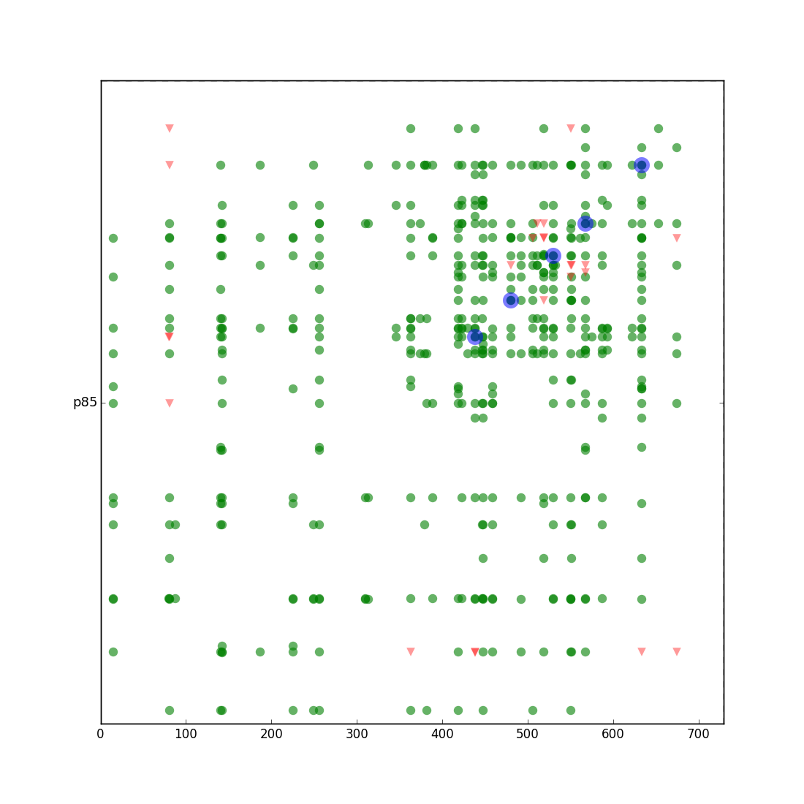

Cross-linked residues (full-length dimer)
Cross-linked residues (full-length dimer)

